Slide 1
Data Literacy Series: Training #3 Progress Monitoring with Short and Long-Term Goals
Division of Field Support and Services Office of Comprehensive Support
February 7, 2024

Slide 2
Please Review
The New Jersey Department of Education may record audio, visuals, participants, and other information sent, verbalized, or utilized during business-related meetings. By joining this meeting, you automatically consent to such recordings. Any participant who prefers to participate via audio only should keep their camera disabled so only their audio will be captured.
PLEASE NOTE: Under certain circumstances, audio/video recording may be restricted. Recording will be in accordance with all applicable federal, state, and local statutes, regulations, or ordinances. As we endeavor to offer a safe, collegial, and inclusive space for collaboration we respectfully request that no participant or third-party entity, on your behalf, record or transcribe today’s conversation. The NJDOE can provide a transcript of these proceedings, upon request. Screenshots, photography, or other copying of chat exchanges is prohibited unless permission is granted by the NJDOE and advance notice is provided to all participants.

Slide 3
Welcome

Slide 4
School Identifications Under the NJ ESSA State Plan

Slide 5
Broad Range of School Partners
Representative of the districts and schools that we support across the State
107 Local Education Agencies (LEAs) in total
Urban (48%), Suburban (34%), & Rural (19%)
From districts with 128 students in Comprehensive and Targeted (C&T) schools to districts with 9,460 students in C&T schools

Slide 6
Improving Schools vs. Exiting Status

Slide 7
Improving vs. Exiting (review)
What’s the difference?
Improving | Exiting
Focuses on your own setting | Focuses on statewide context
Within your locus of control | Outside of your locus of control
Certainly, helps leaders, teachers, and students | Potentially helps leaders, teachers, and students
Only will occur through deliberate actions | May occur through random actions
Is a continuous, time-agnostic process | Is a finite, time-bound process

Slide 8
Exit Criteria: CSI
A school in CSI status has the opportunity to exit status every three years when the identification methodology is used to identify a new cohort of schools. A school may exit status if:
It no longer has a summative score that is at or below the 5th percentile of Title I schools; and
It demonstrates improved student performance on accountability indicators as compared to student performance at the time of identification for comprehensive support and improvement;
Its four-year graduation rate is above 67 percent, if a high school; and
It successfully implemented its approved comprehensive support and improvement plan as confirmed by NJDOE.
Reference: NJAC 6A:33

Slide 9
Exit Criteria: ATSI
A school in ATSI status for low-performing student groups has the opportunity to exit status every three years when the identification methodology is used to identify a new cohort of schools. A school may exit status if:
It no longer has a student group with a summative score that is at or below the 5th percentile of Title I schools; and
It demonstrates, for the student group for which the school was identified as in need of additional targeted support and improvement, improved student performance on accountability indicators as compared to student performance at the time of identification.
Reference: NJAC 6A:33

Slide 10
Exit Criteria: TSI
A school in TSI status for consistently underperforming student groups has the opportunity to exit status every year. A school may exit status if it no longer has a student group that both:
Misses interim targets for all available indicators for two consecutive years; and
Performs below the State average for all available indicators for two consecutive years.
Reference: NJAC 6A:33

Slide 11
Progress Monitoring 201

Slide 12
Please Note for our Exiting Schools
Schools that have met the criteria to be eligible to exit comprehensive support and improvement (CSI), additional targeted support and improvement (ATSI), and/or targeted status and improvement (TSI), will be effective as of June 30, 2024.
Eligible CSI, ATSI, and TSI schools must continue to implement, and progress monitor their approved Annual School Plan (ASP) for the 2023-2024 school year.

Slide 13
Cycle Data and Review Dates
EOC II Data Entered by 2/15/24
EOC II Review with Regional Support Team (in person or virtual)
2/15/24-3/31/24
EOC III Data Entered by 4/15/24
EOC III Desk Audit/Virtual Review
4/15/24-5/20/24
EOC IV Data entered & all data completed by 6/30/24
EOC IV Review with Regional Support Team (in person or virtual)
6/1/24-6/30/24

Slide 14
Monitor and Adjust Course
Monitoring the progress of the Annual School Plan and utilizing data to adjust the course, if necessary, is a space where the impact of the continuous improvement cycle becomes visible.

Slide 15
Monitor and Adjust Course
Establish Routines
Bi-Weekly-Review progress of action steps toward implementation of the evidence-based practices discuss who is responsible for enacting step and gather feedback
Monthly-Review progress with implementation and discuss and agree upon next steps to address action steps that are not on track
Quarterly- Determine if interim goals and being met and if the school is on track to meet the overall SMART goals. The School Leadership Team commits to specific next steps to adjust or stop/start actions if needed. The LEA is knowledgeable about the progress of the plan and commits to supporting the school as needed

Slide 16
Quarterly Cycle Reviews
What data tells if the interim goal is met/not met? Is the school on track to meet the overall goal?
What shifts in systematic/instructional practice can be highlighted based on the data analysis? What intentional changes in your systems and instruction have occurred due to the data analysis?
What has been the impact of the SIA allocation? What accompanying evidence can be provided to support the hypothesis?
What are your next steps?

Slide 17
Staying the Course
Is the school on track to meet the overall goal for the year?
Considerations for not meeting our interim goal.

Slide 18
Take Deliberate Action
To course correct and ensure you are on track to meet overall goals
As you review the data for the End of Cycle II consider:
Are you implementing the evidence-based practices with fidelity and intentionality and is it improving student outcomes?

Slide 19
Course Correcting
Did you meet the interim goal? No
What role did the implementation of the intervention (Evidence Based Practice) have in not meeting this goal?
What other factors contributed to not meeting the benchmark?
What has been the impact of the SIA thus far? If you have not been able to spend the funds at this time, who can you contact from central office to assist with your expenditures? Do you need to re-allocate funds to meet current priority needs?
What actions are being taken to meet the next benchmark for this goal?

Slide 20
Review Strategies Listed in the ASP

Slide 21
ASP: Comprehensive Needs Assessment
Evaluation of Prior Year Interventions
Interventions will Pre-Populate in the 24-25 ASP

Slide 22
Review Strategies

Slide 23
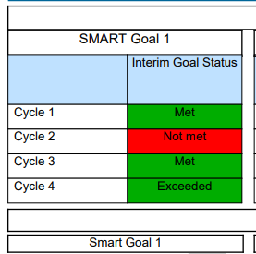
Course Correcting
Course Correcting can lead to improved student outcomes

Slide 24
Break
We will take a five-minute stretch break.

Slide 25
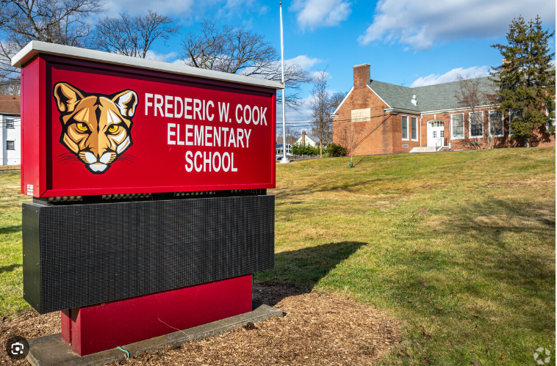
Exiting Status: School Leader Discussion
Frederic Cook Elementary School
Dr. Caryn Cooper
Identified for Comprehensive Status in 2017-2018 school year
57.5% -Economically Disadvantaged
18.4% -English Language Learners
64.7% -Black or African American
31.9% -Hispanic
1%-White
Summative Rating: Percentile Rank 3.79

Slide 26
Pathway to School Improvement
Leveraged the Work of the Annual School Plan
Growth and Reflection Rubric
Clear Mission
Refine PLCs establish norms to deal with conflict and review authentic student work during PLCs
Formative Assessments

Slide 27
Levers for School Improvement
Mission & Vision
High Expectations for Students
"All Students can Achieve"
PLCs
Consistent
Establish norms and develop protocols to examine student work during PLCs
Establish norms to resolve conflicts
Formative Assessment
Teachers developed standards aligned formative assessments based on priority standards and were administered in between benchmarks

Slide 28
Principal Data Chats
The principal meets with the teachers three times a year
Review benchmark data, determine student progress, and discuss the next steps for support
Transformed the culture of the building
Students are progressing.
To what extent are they progressing?

Slide 29
Cook Exited Status in June 2023
Improved metrics across the board
 | 2017-18 | 2022-23
ELA Perf. | 34.6 | 41.5
Math Perf. | 28.6 | 37.5
ELA mSGP | 43 | 66
Math mSGP | 25.5 | 59
ELP Progress | 25 | 40
Percentile Change | 3.8 | 67.2
6th of 2046

Slide 30
Data Cleanliness

Slide 31
Data Cleanliness Campaign
Originally launched in Fall 2019
Sought to support districts with their various NJSMART submissions:
SID Management V. CTE Submission
SMID Management VI. State Assessment Registration Submission
Special Education Submission VII. Performance Reports Submission
Course Roster Submission
(Student & Staff)

Slide 32
Why Clean Data?
How do we retain teachers in hard-to-staff content areas?
Which student groups’ performance are we federally accountable for?
How many multilingual learners are we adding per year?
What schools will need more faculty next fiscal year?
Source: NSJMART – SID Management FAQs (link here)

Slide 33
Error Reporting

Slide 34
Error Reporting

Slide 35
Rubric for Success

Slide 36
Next Steps

Slide 37
Next Steps
Reach out to district leadership if you have not heard about your school’s status for 2024-25
Cycle 2 data is due by 2/15
Be sure to register for an attend our Technical Assistance (TA) sessions if you are at a school that has been re-identified
Be sure to register for our sustainability planning session by this Friday if you are at a school that is eligible to exit this June 2024

Slide 38
Presenter Contact Information
Jennifer Hobbs Data Specialist, RST-North (973) 902-6969 jennifer.hobbs@doe.nj.gov
Reina Irizarry-Clark Data Specialist, RST-Central (609) 658-0366 reina.irizarry-clark@doe.nj.gov
Lindsay Wilhelmi-Guay Data Specialist, RST-South (856) 301-0087
lindsay.wilhelmi-guay@doe.nj.gov
Dr. Chimaobi Amutah Statewide Data Manager State Transformation Specialist (609) 468-7349 chimaobi.amutah@doe.nj.gov
Matthew Norcross Data Analyst (856) 372-0238 matthew.norcross@doe.nj.gov

Slide 39
Questions

Slide 40
Thank You!
New Jersey Department of Education: nj.gov/education
Office of Comprehensive Support: OCS@doe.nj.gov
ASP Technical Support: ASP@doe.nj.gov
Follow Us!
Facebook: @njdeptofed
Twitter: @NewJerseyDOE
Instagram: @NewJerseyDoe

